Slide 1

Project Final Presentation & Demonstration on “FoodFinder : A restaurant recommender system”
Students:
Varsha Ravindra (1RN115CS119)
Sunidhi Hegde (1RN15CS110)
Guide:
Dr. Shashidhara H R
Asst. Prof. Dept. of CSE, RNSIT
Department of Computer Science and Engineering
RNS INSTITUTE OF TECHNOLOGY
2018-19

Slide 2
CONTENTS
INTRODUCTION
Problem Statement
Existing System and Limitations
Proposed system
REQUIREMENTS
Functional Requirements
Non-functional Requirements
Hardware & Software Requirements
SYSTEM ARCHITECTURE/BLOCK DIAGRAM
System architecture
DETAILED DESIGN
Modules implemented
Libraries used
IMPLEMENTATIONS
Algorithms used
RESULT ANALYSIS
Snapshots
CONCLUSION
Conclusion
REFERENCES

Slide 3
INTRODUCTION
Problem Statement
Providing related content out of relevant and irrelevant collection of items to users of online service providers.
Restaurant recommender system aims to recommend restaurants to users based on user-restaurant ratings, reviews, price and location

Slide 4
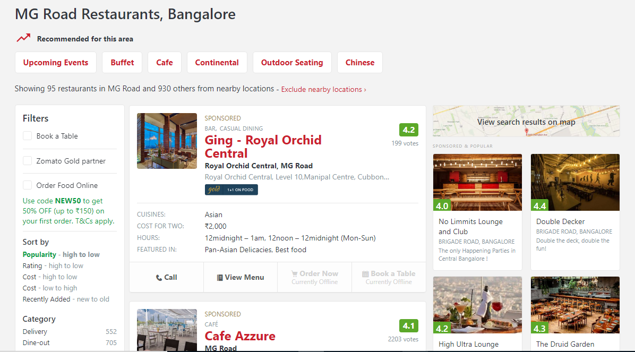
Existing system and it’s limitations
Does not take user interest into account
Less accountable result

Slide 5
Proposed system
A restaurant recommender system which uses content-based and collaborative filtering to provide recommendations.
Advantages
Higher performance
Better results

Slide 6
REQUIREMENTS
Hardware Requirements:
System: Pentium IV 2.4 GHz
Hard disk: 500 GB
RAM: 4GB
Software Requirements:
Operating System: Windows 7 / higher
Programming language: Python 3
IDE: PyCharm
Database: MongoDB

Slide 7
Functional Requirements:
Take user input and provide recommendations accordingly.
If the user has previously ordered using the application, recommendations are provided based on the order history.
Non-Functional Requirements:
Improved accuracy.
Improved performance.

Slide 8
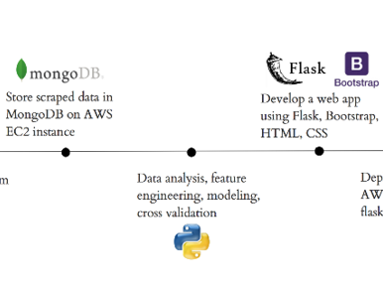
SYSTEM ARCHITECTURE

Slide 9
DETAILED DESIGN
Modules implemented:
Web scraping with Python using BeautifulSoup.
Data cleaning.
UI Design. Front-end code has been integrated with Python using Flask.
Successful establishment of connection with MongoDB.
.Quiz for a new user.
Content-based system for intermediate users.
Item-based collaborative filtering for super user.

Slide 10
Libraries Used:
BeautifulSoup - Beautiful Soup is a Python library for pulling data out of HTML and XML files.
Flask - It is one of the most popular Python web application frameworks.
PyMongo - It is a Python distribution containing tools for working with MongoDB.
Pandas - It is a software library written for the Python programming language for data manipulation and analysis.
Sklearn - Scikit-learn is a free software machine learning library for Python.

Slide 11
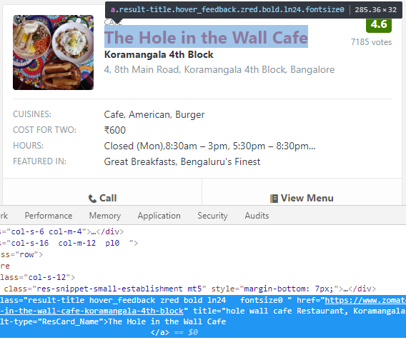
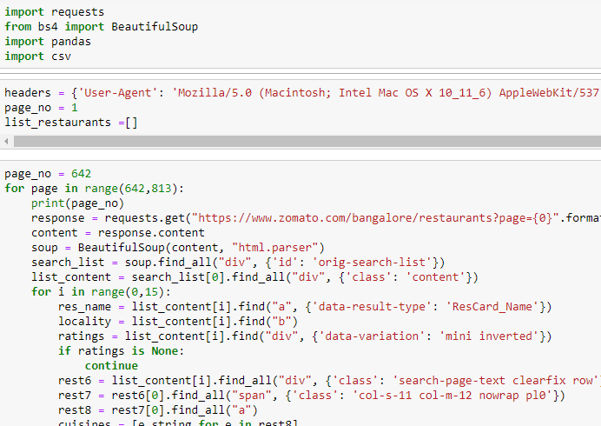
IMPLEMENTATION
Web scraping with Pythom using Beautiful Soup

Slide 12
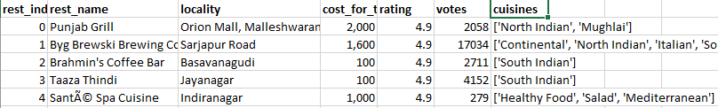


Data cleaning and preparation
Removing restaurants with no ratings.
Get a list of unique cuisines.
Strip the data of whitespaces.
Sort the restaurants.

Slide 13
Algorithm for ‘New User’ (Take your pick):
Determine the minimum number of votes required by a restaurant to be listed in qualified_restaurants.
min_votes = df['votes'].quantile(0.50)
Calculate the ‘score’ for each restaurant using the formula: (v/(v+m) * R) + (m/(m+v) * C)
where v – number of votes
m – min_votes calculated in the previous step
R – rating of each restaurant
C – average rating
Arrange restaurants in decreasing order of score.
Input the list of cuisines.
Match the restaurants containing the cuisines.
Select top 7 restaurants for recomendations.

Slide 14
Algorithm for ‘Intermediate User’ (Content-based approach)
Get the index of the restaurant that matches the restaurant name inputted.
Get the list of cosine similarity scores for that particular restaurant with all restaurants. Convert it into a list of tuples where the first element is its position and the second is the similarity score.
Sort the restaurants based on the similarity score.
Get the restaurant indices based on the similarity score.
Get the restaurant name based on the restaurant indices.
Get the list of restaurants for which recommendations is not possible.
While recommending to a user:
Go further only if the username entered is present in the dataset.
Get the number of restaurants that the user has rated.
Iterate through the restaurants that the user has rated.
Stop if the restaurant is present in the list of restaurants for which recommendations is not possible or if the restaurant has < 3.0 ratings.
Else generate a list of recommendations for each restaurant that the user has rated.

Slide 15
Algorithm for ‘Super User’ (Collab-filtering approach)
Pivot table with cust_name , rest_name with cust_ratings as the column to aggregate.
Using the pivot table, find Pearson’s correlation.
Input the username.
Get a list of all restaurants rated by the user.
For each restaurant in the list:
Use the correlation matrix and get the row of that particular restaurant. Drop all NaN values.
Multiply each of the correlation value with the rating that particular restaurant.
You now have a series containing the index of the restaurants along with its correlation to the inputted restaurant.
Arrange this series in decreasing order of the correlation score.
Obtain the top recommendations and get the restaurant name using the index

Slide 16
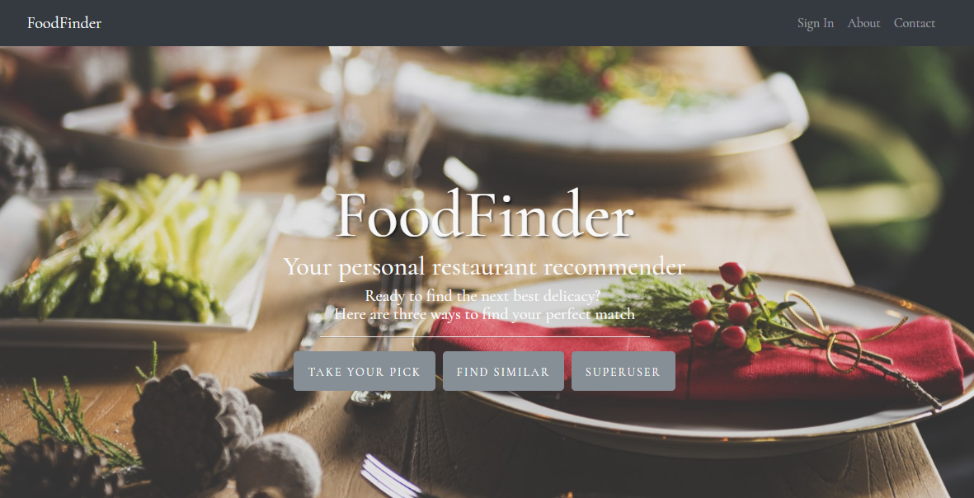
RESULT SNAPSHOTS
Home page:

Slide 17
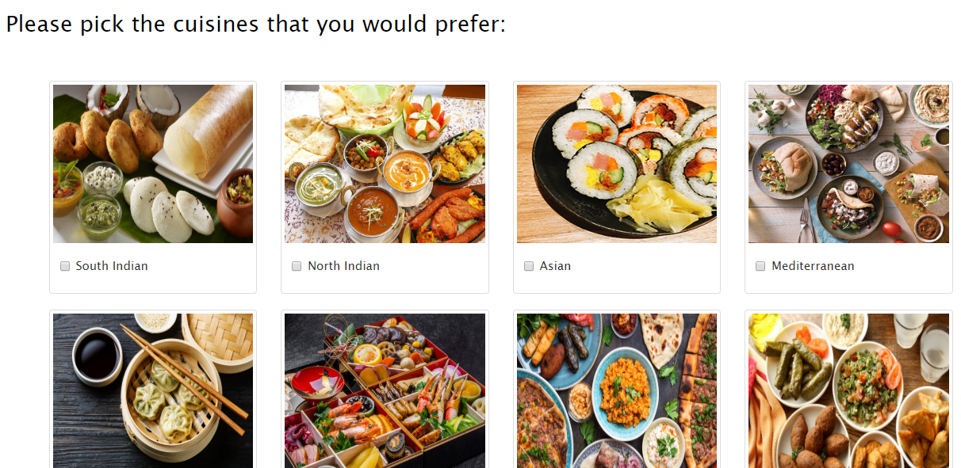
Take your pick:

Slide 18
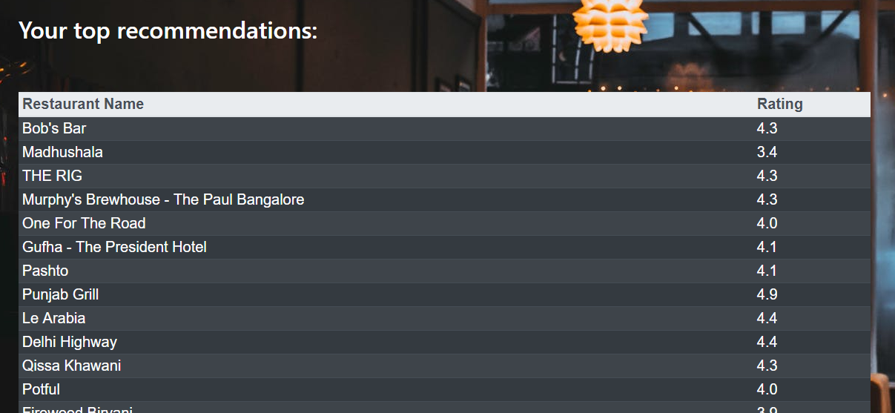
Recommendations:

Slide 19
CONCLUSION
Existing system limitations
Does not take user interest into account
Less accountable result
Proposed system
A restaurant recommender system which uses content-based and item-based collaborative approach to provide recommendations to user.
Advantages
Higher performance.
More accurate results.

Slide 20
REFERENCES
[1] Hybrid recommender systems: Survey and experiments, User-modelling and User-adapted interactions , November 2002
[2] https://www.sciencedirect.com/science/article/pii/S1110866515000341
[3] https://www.datacamp.com/community/tutorials/recommender-systems-python
[4] https://en.wikipedia.org/wiki/Recommender_system
[5] https://www.marutitech.com/recommendation-engine-benefits/
[6] https://towardsdatascience.com/my-journey-to-building-book-recommendation-system-5ec959c41847

Slide 21

PROJECT SETUP AND DEMONSTRATION

Slide 22
Suggestions….!

Slide 23
THANK YOU!!!

